Slide 1
The Naked Functions programming model
See also: Getting started with Naked Functions

Slide 2
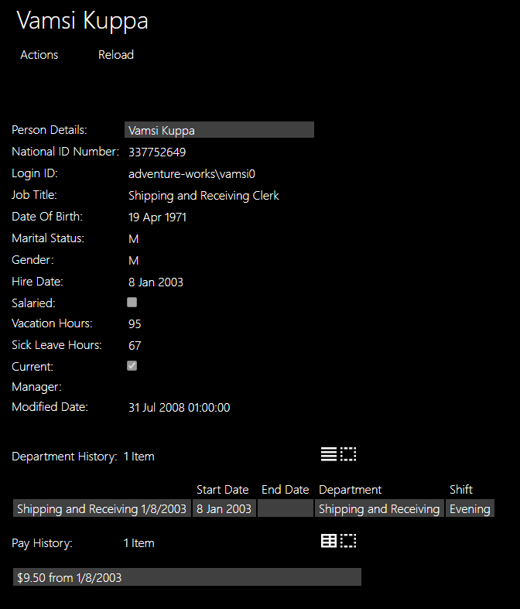
Most views are generated automatically from the underlying record
A record (in C# 9) is an immutable class. Properties have an init rather than a set, which means the property may only be set when constructing the object.
public record Employee
{
[Hidden]
public virtual int EmployeeID { get; init; }
[MemberOrder(1)]
public virtual Person PersonDetails { get; init; }
...
[MemberOrder(12)]
public virtual string JobTitle { get; init; }
...
[MemberOrder(16), Mask("d")]
public virtual DateTime? HireDate { get; init; }
...
[TableView(true,
nameof(EmployeeDepartmentHistory.StartDate),
nameof(EmployeeDepartmentHistory.EndDate),
nameof(EmployeeDepartmentHistory.Department),
nameof(EmployeeDepartmentHistory.Shift))]
public virtual ICollection<EmployeeDepartmentHistory> Depart
public override string ToString() => $"{PersonDetails}";
}

Slide 3
Each visible property is rendered as a field
public record Employee
{
[Hidden]
public virtual int EmployeeID { get; init; }
[MemberOrder(1)]
public virtual Person PersonDetails { get; init; }
...
[MemberOrder(12)]
public virtual string JobTitle { get; init; }
...
[MemberOrder(16), Mask("d")]
public virtual DateTime? HireDate { get; init; }
...
[TableView(true,
nameof(EmployeeDepartmentHistory.StartDate),
nameof(EmployeeDepartmentHistory.EndDate),
nameof(EmployeeDepartmentHistory.Department),
nameof(EmployeeDepartmentHistory.Shift))]
public virtual ICollection<EmployeeDepartmentHistory> Depart
public override string ToString() => $"{PersonDetails}";
}
4. [Hidden] tells the framework that this property is never displayed to the user
1. The property name is reformatted to provide the field label.
2. The optional MemberOrder attribute gives control over layout
3. Mask is one of several available attributes that give more control over formatting or other presentation behaviours.

Slide 4
If the property type is a domain type, it is rendered as a navigable link
public record Employee
{
[Hidden]
public virtual int EmployeeID { get; init; }
[MemberOrder(1)]
public virtual Person PersonDetails { get; init; }
...
[MemberOrder(12)]
public virtual string JobTitle { get; init; }
...
[MemberOrder(16), Mask("d")]
public virtual DateTime? HireDate { get; init; }
...
[TableView(true,
nameof(EmployeeDepartmentHistory.StartDate),
nameof(EmployeeDepartmentHistory.EndDate),
nameof(EmployeeDepartmentHistory.Department),
nameof(EmployeeDepartmentHistory.Shift))]
public virtual ICollection<EmployeeDepartmentHistory> Depart
public override string ToString() => $"{PersonDetails}";
}
The user may click on the link to view the associated object, or right-click to view it in the other half of the screen.

Slide 5
Collection properties are recognised and rendered as such
public record Employee
{
[Hidden]
public virtual int EmployeeID { get; init; }
[MemberOrder(1)]
public virtual Person PersonDetails { get; init; }
...
[MemberOrder(12)]
public virtual string JobTitle { get; init; }
...
[MemberOrder(16), Mask("d")]
public virtual DateTime? HireDate { get; init; }
...
[TableView(true,
nameof(EmployeeDepartmentHistory.StartDate),
nameof(EmployeeDepartmentHistory.EndDate),
nameof(EmployeeDepartmentHistory.Department),
nameof(EmployeeDepartmentHistory.Shift))]
public virtual ICollection<EmployeeDepartmentHistory> Depart
public override string ToString() => $"{PersonDetails}";
}
1. The user may open a view of any collection as a List or Table – by default showing all fields a columns.
2. The optional TableView attribute gives control over which columns are shown and in what order.

Slide 6
The view title is taken from the type’s ToString method
public record Employee
{
[Hidden]
public virtual int EmployeeID { get; init; }
[MemberOrder(1)]
public virtual Person PersonDetails { get; init; }
...
[MemberOrder(12)]
public virtual string JobTitle { get; init; }
...
[MemberOrder(16), Mask("d")]
public virtual DateTime? HireDate { get; init; }
...
[TableView(true,
nameof(EmployeeDepartmentHistory.StartDate),
nameof(EmployeeDepartmentHistory.EndDate),
nameof(EmployeeDepartmentHistory.Department),
nameof(EmployeeDepartmentHistory.Shift))]
public virtual ICollection<EmployeeDepartmentHistory> Depart
public override string ToString() => $"{PersonDetails}";
}
The title may be constructed from the values in multiple fields and/or from the title(s) of associated object(s) by using an interpolated string.

Slide 7
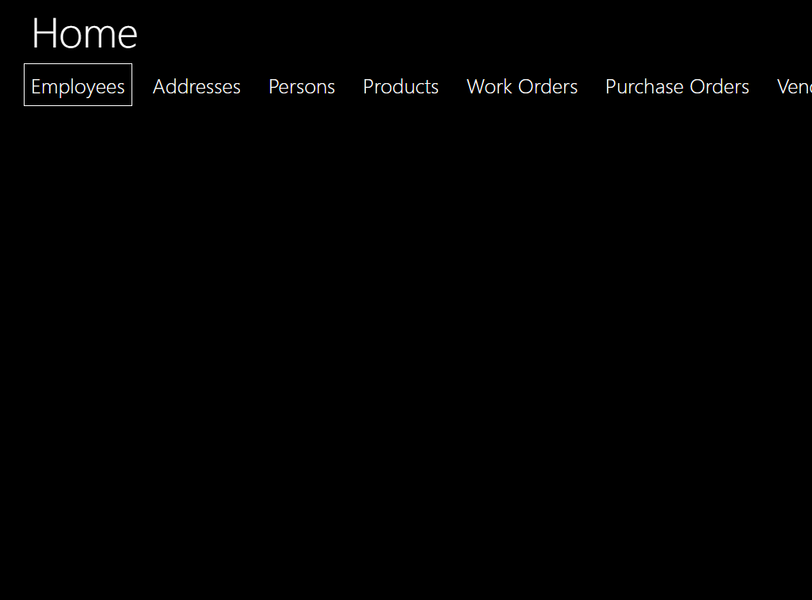
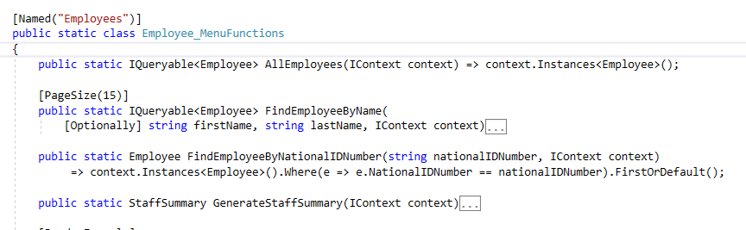
Main menus are specified by static classes
1. By default the menu name is a reformatted version of the class name, but this may be overridden with an optional Named attribute.

Slide 8
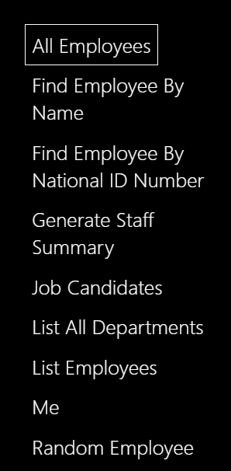
Each action on the open menu corresponds to a function on that type
1. The action name derived from the function name unless specified explicitly with another Named attribute.
3. If the returned type is IQueryable, the instances are automatically ‘paged’, and the default page size of 20 may be optionally overridden with a PageSize atttibute.
2. The return type, here, specifies what will be displayed to the user: either a single instance of a domain record type, or a collection of instances.

Slide 9
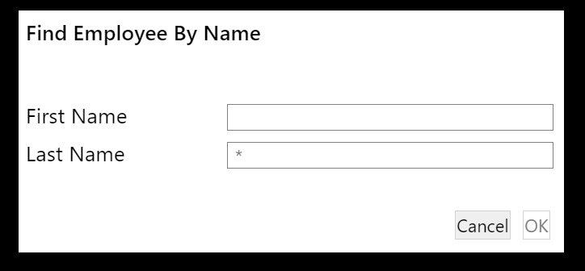
The dialog is derived directly from the function parameter list
1. The parameter name is used (reformatted) as a label, and the parameter type used to provide generic validation and/or other behaviour at the UI.
2. All parameters are made mandatory at the UI unless an Optionally attribute is added.

Slide 10
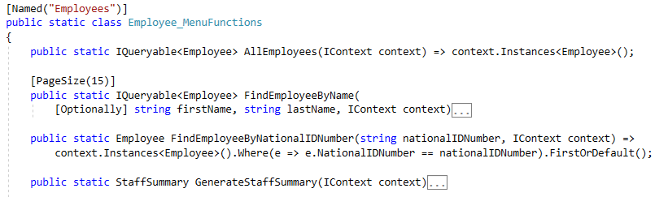
An IContext provides access to instances
1. An IContext parameter does not appear at the UI. If the function has no other parameters, then the menu action executes immediately, with no dialog.
2. The IContext provides access to an IQueryable of any domain type, to which LINQ may be applied.

Slide 11
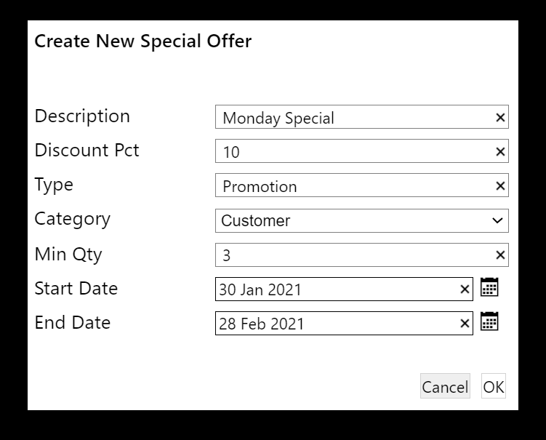
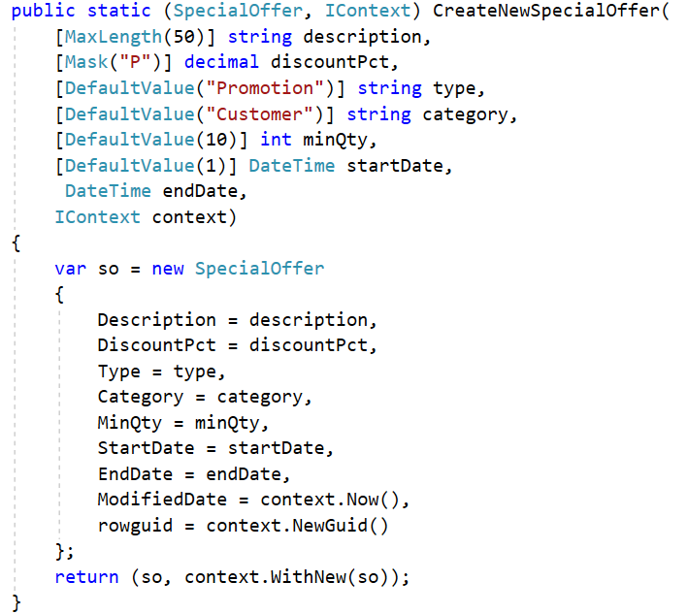
An action to create and save a new object…
1. The function returns a 2-tuple. The first item is the object (or collection) that will be displayed when the action has completed; the second is an IContext.
2. The function defines parameters for at least each of the mandatory properties of the new object, plus an IContext.
3. MaxLength, Mask, and DefaultValue specify behaviour of the generated dialog. For a DateTime parameter a date-picker (calendar icon) is automatically added and DefaultValue(n) means ‘n days after today’.
5. Important: CreateNewSpecialOffer is a pure function: it does not mutate the state of any object, nor of the external system. After this function has exited, the NakedFunctions framework reads the returned tuple, saves any new objects on the context to the database, and sends the same or other specified objects to the UI.
4. The returned context must be advised of all persistent objects that have been created. WithNew does not mutate the IContext: it returns a copy of the context with the new object(s) added.

Slide 12
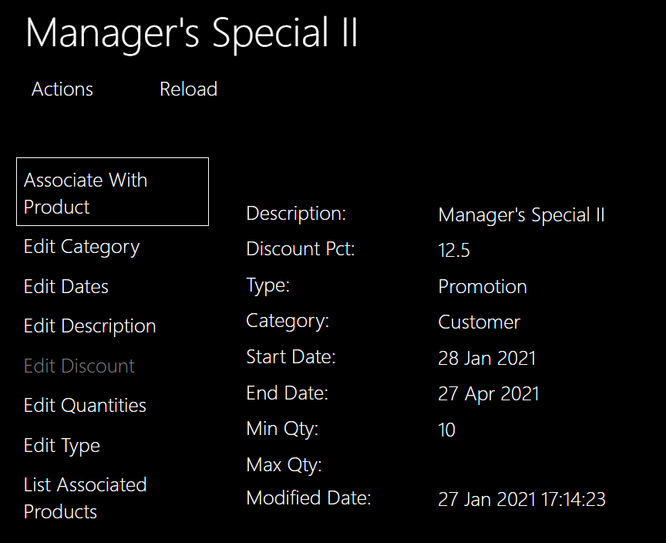
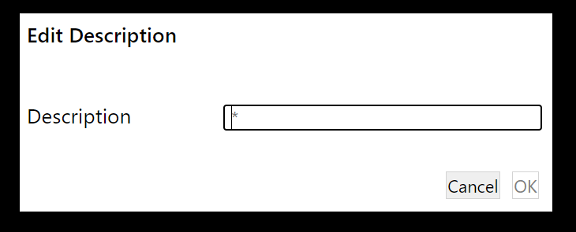
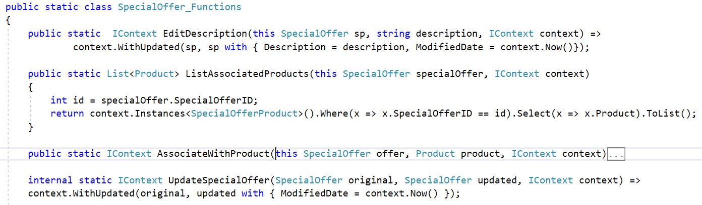
Actions contributed to an object…
1. Displayed objects have their own Actions menu.
2. Any function using C# extension method syntax (this) is automatically contributed to the Actions menu of the type. Note that in the resulting dialog, the ‘this’ parameter is not rendered. When the user hits OK, the framework will call the corresponding function, providing the this parameter automatically (along with an IContext).
3. If the function does not require that the user is re-directed to a different object, then it may return just the context.
4. WithUpdated returns a new context with details of the updated object (before and after) added, for processing by the framework once the whole function has exited.
5. The with keyword creates a copy of the object, with just the differences specified in the following braces. In C# 9 with works only on records; from C# 10 it will work with classes also.

Slide 13
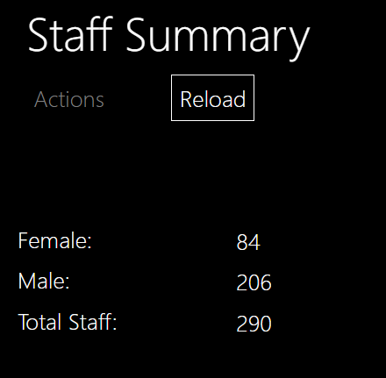
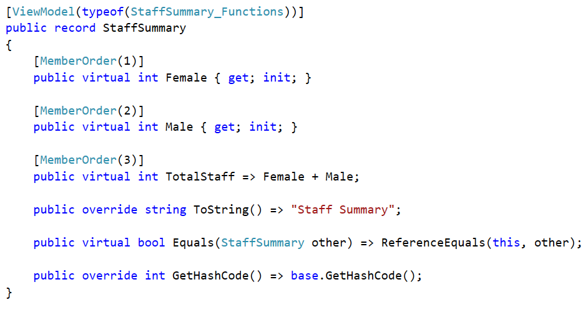
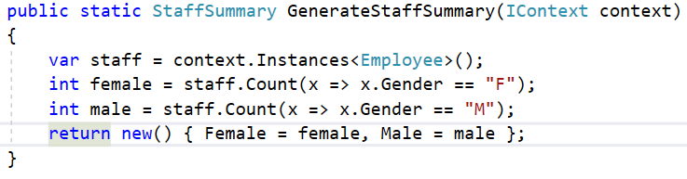
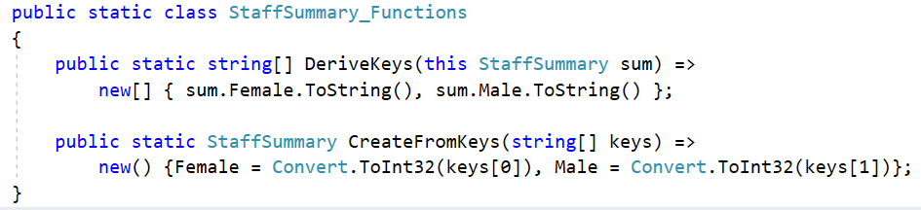
View Models…
1. A view model looks like any other object at the UI, but is not persisted in the database.
2. It is defined as an immutable record, like a persistent object, but is marked up with the ViewModel attribute, which specifies a type that contains the two functions DeriveKeys and CreateFromKeys for this specific type of view model.
3. A view model is created using the standard C# new syntax. The context is needed only to look up other objects if needed. (In this case the required type of StaffSummary is inferred from the function signature).

Slide 14
These attributes may be used to provide hints - to be interpreted and used by the Client.
[Bounded]
[CreateNew]
[DefaultValue]
[DescribedAs]
[DisplayAsProperty]
[Edit]
[Hidden]
[Mask]
[MaxLength]
[MemberOrder]
[MinLength]
[MultiLine]
[Named]
[Optionally]
[PageSize]
[Password]
[Plural]
[PresentationHint]
[RegEx]
[RenderEagerly]
[TableView]
[ValueRange]
[Versioned]
[ViewModel]
Follow links to see one example of how the attribute may be used. (Some of the attributes may be used in more than one way.)

Slide 15
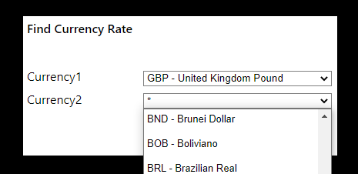
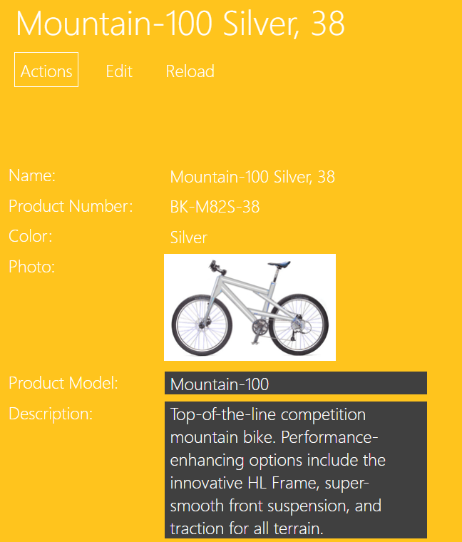
Some examples of using attributes
1. If a type is known to have a limited number of instances, it may be marked [Bounded]. Whenever this type is used as a parameter in a dialog, the user will be presented with all instances in a drop-down list.
[Bounded] public record Currency
[DisplayAsProperty, MemberOrder(11)]
public static ProductDescription Description(this Product product) =>
product.ProductModel is null ? null : ProductModel_Functions.LocalCultureDescription(product.ProductModel);
2. [DisplayAsProperty] will render a read-only function as a property on the type, at the UI.

Slide 16
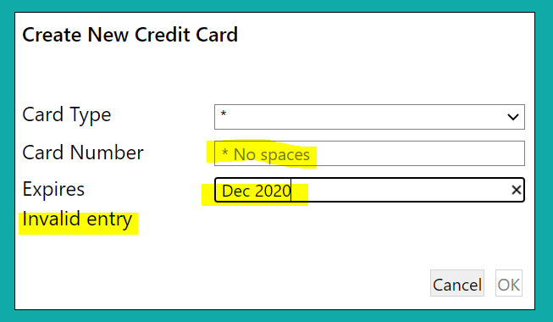
Some more examples of using attributes
public static IContext CreateNewCreditCard(this Person p,
string cardType,
[RegEx("^[0-9]{16}$")][DescribedAs("No spaces")] string cardNumber,
[RegEx("^[0-9]{2}/[0-9]{2}")][DescribedAs("mm/yy")] string expires,
IContext context) => …
1. [DescribedAs] provides user help. On a parameter the text will be displayed as a ‘placeholder’ in the empty dialog field; when applied to a function, the text will be rendered as a tooltip – seen when the mouse hovers over the corresponding action in a menu.
1. [RegEx] provides a convenient way to specify validation rules on string parameters.

Slide 17
‘Complementary functions’ define behaviour to be associated (by the framework) with another function
Validate one or more parameter values – using custom rules
See also [ValueRange], [MaxLength],[MinLength],[RegEx] attributes
AutoComplete a reference parameter
Present the user with Choices for a parameter value – using custom rules
See also [Bounded] attribute
Specify the Default value for a parameter – using custom rules
See also [DefaultValue] attribute
Disable an action based on specified conditions
Hide an action or property based on specified conditions
See also [Hidden] attribute

Slide 18
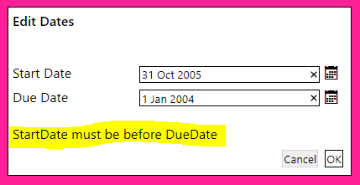
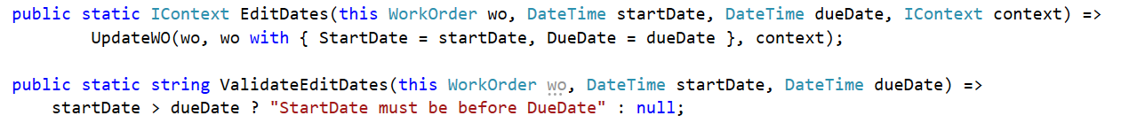
Validate one or more parameter values – using custom rules
1. This function ‘complements’ the EditDates function: it has the same name, with the Validate prefix. It will be called automatically by the framework when the user hits OK on the action dialog.
2. If the function returns null (or empty string), the EditDates function will be called with the dialog parameters. If a non-empty string is returned, EditDates will not be called, and the user will be presented with the validation message.
3. ValidateEditDates must take all the parameters of EditDates – same types and names (except for the IContext, which is optional). This permits ‘co-validation’. If desirable, individual parameters may have their own validation functions e.g. to validate just the startDate, the function would be named Validate1EditDates, and would take only the this parameter (the ‘contributee’) and the startDate parameter.

Slide 19
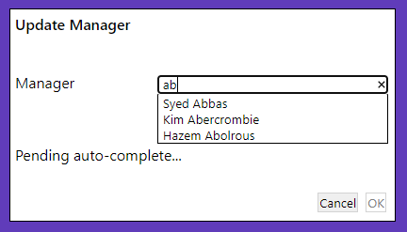
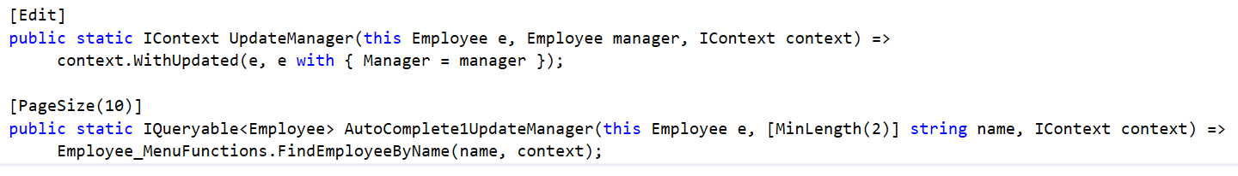
AutoComplete a reference parameter
1. Parameter 1 here requires an Employee object. The user may locate one separately and paste the reference into the dialog, but it is more convenient to just start typing the employee’s name and select from a list
2. The name of this function indicates that it provides auto-complete functionality for parameter 1 of the UpdateManager function. (Both functions must be defined on the same static class).
3. Specifies that no call will be made to the server until the user has typed at least 2 characters.
4. Specifies that only first 10 matches are offered to the user in the drop-down list
5. Here, the execution of the auto-complete function is delegated to an existing Find function used on the Employee menu.

Slide 20
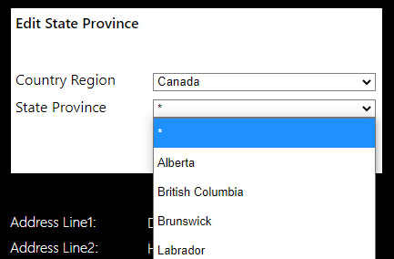
Present the user with choices for a parameter value – using custom rules
1. See also: [Bounded] attribute.
2. Choices for any parameter may be specified using a Choices complementary function, either creating instances as needed or filtering
public static IContext EditCategory(this SpecialOffer sp, string category, IContext context) =>
context.WithUpdated(sp, sp with { Category = category, ModifiedDate = context.Now() });
public static IList<string> Choices1Category(this SpecialOffer sp) => new[] { "Reseller", "Customer" };
public static IContext EditStateProvince(this Address a,
CountryRegion countryRegion, StateProvince stateProvince, IContext context) =>
UpdateAddress(a, a with { StateProvince = stateProvince }, context);
public static IList<StateProvince> Choices2EditStateProvince(this Address a,
CountryRegion countryRegion, IContext context) =>
StateProvincesForCountry(countryRegion, context);
3. Choices for one parameter may be made dependent on the value selected for another parameter. Here, the choices offered for parameter 2 (stateProvince) are based on the user’s selection of parameter 1 (countryRegion)

Slide 21
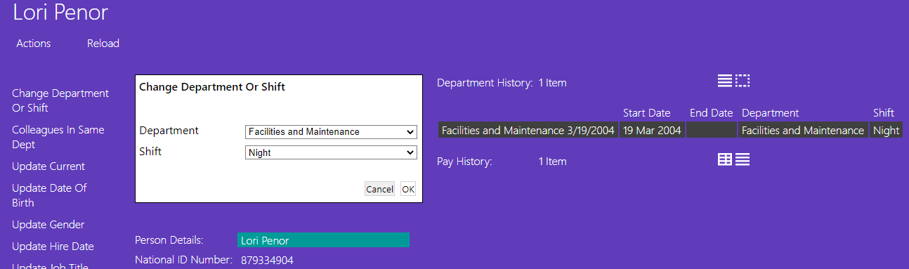
Specify the default value for a parameter - using custom rules
1. Here we want the default values (from the drop-down lists) to be the Employee’s existing Department and Shift
public static IContext ChangeDepartmentOrShift( this Employee e, Department department, Shift shift, IContext context) => …
public static Department Default1ChangeDepartmentOrShift(this Employee e) => CurrentAssignment(e)?.Department;
public static Shift Default2ChangeDepartmentOrShift(this Employee e) => CurrentAssignment(e)?.Shift;
private static EmployeeDepartmentHistory CurrentAssignment(Employee e) => e.DepartmentHistory.Where(n => n.EndDate == null).FirstOrDefault();
2. Default values are specified for parameters 1 & 2, derived from information in the Employee object

Slide 22
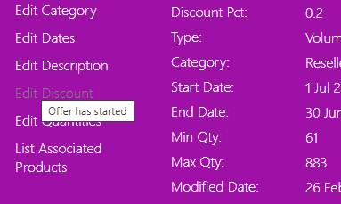
Disable an action based on specified conditions
public static IContext EditDiscount(this SpecialOffer sp, decimal discountPct, IContext context) => UpdateSpecialOffer(sp, sp with { DiscountPct = discountPct }, context);
public static string DisableEditDiscount(this SpecialOffer sp, IContext context) => context.Today() > sp.StartDate ? "Offer has started" : null;
1. We do not want the user to be able to alter the discount once the offer has started
2. A complementary Disable function is used. If this returns null (or an empty string) then the action is enabled. If not it is disabled, and greyed-out on the UI. The returned explanatory message will be rendered as a tooltip – shown if the user hovers on a disabled action.

Slide 23
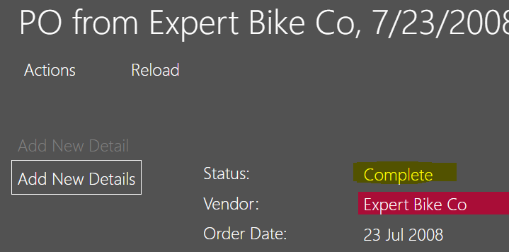
Hide an action or property based on specified conditions
1. The Approve action on a PurchaseOrderHeader should only be shown to the user while it is in a pending state.
public static IContext Approve(this PurchaseOrderHeader po, IContext context) => UpdatePOH(po, po with { Status = 2 }, context);
public static bool HideApprove(this PurchaseOrderHeader po) => !po.IsPending();
public static bool HideLoginID(Employee e, IContext context) { var userAsEmployee = Employee_MenuFunctions.CurrentUserAsEmployee(context); return userAsEmployee != null ? userAsEmployee.LoginID != e.LoginID : true; }
2. A complementary Hide function is used, which simply returns true or false.
3. A Hide function may also be used to hide a property on a type. This one hides the property named LoginID in an Employee, unless the logged on user is that employee.

Slide 24

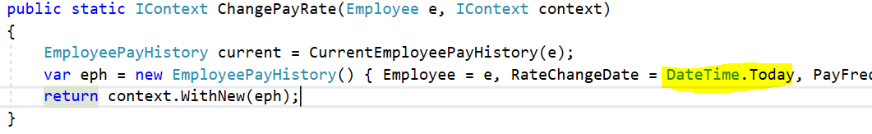
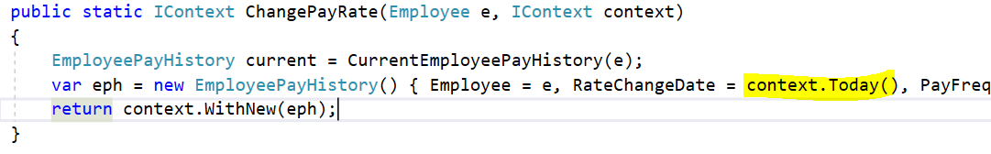
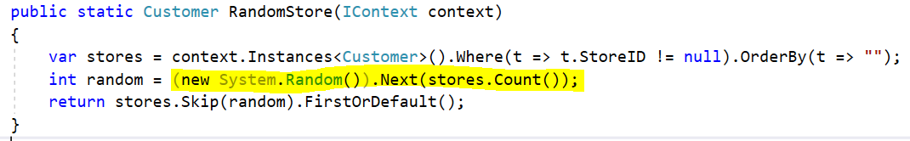
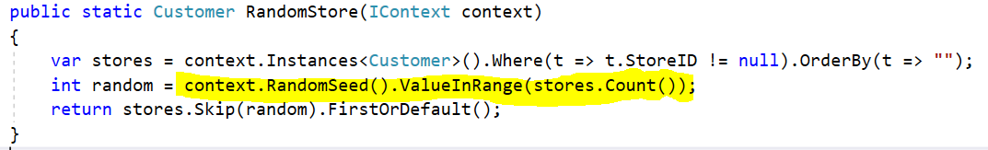
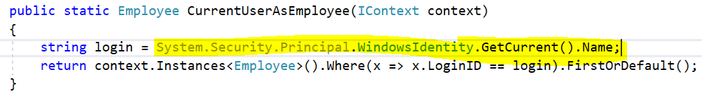
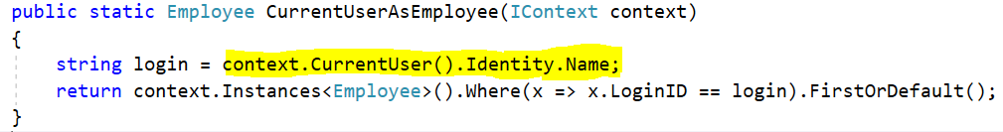
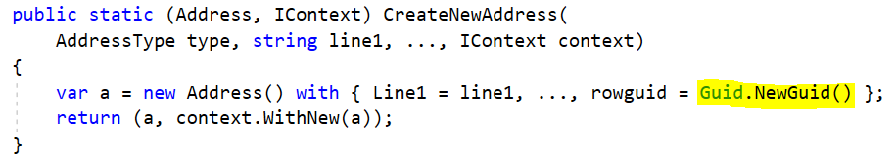
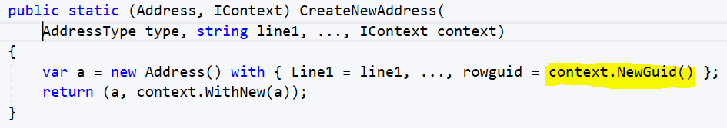
IContext provides helpers, so domain functions need never have direct dependencies, or impact, on System state (illegal in a pure function)

Slide 25
These helper functions delegate to system services provided by the framework
The services are defined by interfaces:
IClock
IRandomSeedGenerator
IPrincipalProvider
IGuidGenerator
The default implementation of each service may be replaced with a custom implementation
This is especially useful in testing e.g. using a fixed, or programmable clock
Custom implementations are simply registered in the ConfigureServices method on StartUp.cs e.g.:

Slide 26
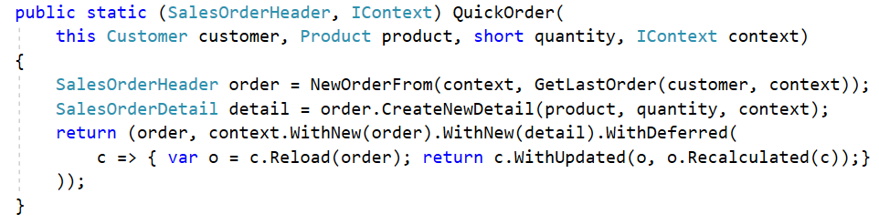
Advanced: A ‘deferred function’ is registered on the context, and will be executed by the framework only after the main function has exited and any changes have been saved to the database.
1. QuickOrder creates a new order and a new detail object, both to be saved. The Recalculated function will update the order’s Total, but this will only work after the order and detail have been saved, and the detail appears in the order’s Details collection. Hence the recalculation is specified as a ‘deferred function’.
2. The deferred function is registered thus:
3. The deferred function is of type Func<IContext, IContext>. It may be specified as a lambda or a standalone function.
4. By defining it as a lambda, it can bind references from the scope of the original function, such the (sales) order, here. If that object will already have been updated by QuickOrder before the deferred function is called, then it should be reloaded before being used.
5. The deferred function may make further updates to any objects, or create and save new ones - by registering them on the returned context, for subsequent execution by the framework.

Slide 27
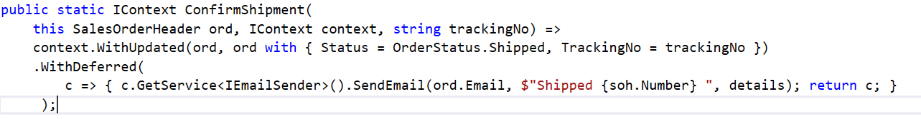
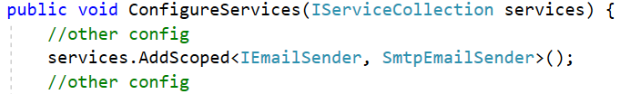
A deferred function may also generate side effects - without breaking the pure functional paradigm
1. ConfirmShipment updates the order, but also needs to send a confirmation email to the customer – which necessarily generates a side-effect.
2. The email is sent using a deferred function, which won’t be executed until after ConfirmShipment has exited – so ConfirmShipment remains a pure side-effect-free function.
3. The context’s GetService method provides access to any system service…
… that has been registered in the ConfigureServices method on StartUp.cs in the Server project.

